Slide 1



MDS Changes are Coming – Part 3
Sections: G, GG, H, I
Are you ready for October 1, 2023?
Debra Wright, RN, BSN, RAC-CT
Quality Improvement Specialist

Slide 2
Helpful Links
MDS FORMS AND RAI MANUAL
  https://www.cms.gov/medicare/quality-initiatives-patient-assessment-instruments/nursinghomequalityinits/mds30raimanual
CMS Official YouTube Channel
  https://www.youtube.com/cmshhsgov

Slide 3


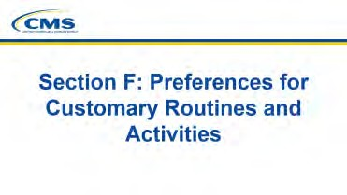
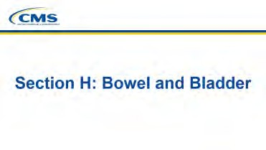
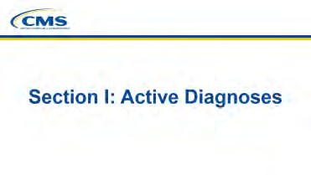
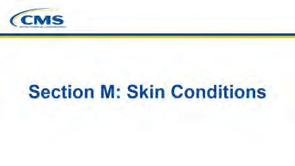
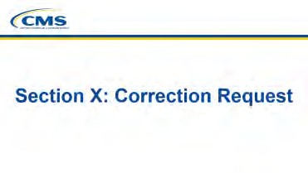
CMS Library of Training Videos

Slide 4
Global Changes to the MDS 3.0 RAI Manual
Content updated with gender-neutral language.
Minor updates to wording to enhance understanding.
Coding examples modified to improve clarity.
Quality Improvement and Evaluation System (QIES) was changed to iQIES.
Revisions made pertaining to legal/proxy information for family member, significant other, and/or guardian/legally authorized representative to provide consistency.
Understanding Changes to the MDS 3.0 RAI v1.18.11

Slide 5
Where are the changes?
Revisions to Chapter Guidance
Chapter 1
Chapter 2
Chapter 4
Revised Data Elements and/or New/Revised Guidance in Chapter 3
Section A
Section B
Section C
Section D
Section F
Section GG
Section H
Section I
Section J
Section K
Section M
Section N
Section O
Section Q

Slide 6
Section G – Activities of daily living
FYI
Removed for Federally required MDS
Most items have either been retired or moved into section GG
Depending on your State, some sections will still be on the OSA

Slide 7


Section GG – Functional Abilities and Goals

Slide 8
The Intent of Section GG
This section includes items about functional abilities and goals. It includes items focused on prior function, admission and discharge performance, discharge goals, performance throughout a resident’s stay, mobility device use, and range of motion. Functional status is assessed based on the need for assistance when performing self-care and mobility activities.

Slide 9
Section GG
Data elements from Section G were revised and incorporated into GG
ADL assistance
Bathing
Balance during transfers and walking
Rehabilitation Potential

Slide 10
Section G data elements added to GG:
Functional Limitation in Range of Motion
Mobility Devices
Personal Hygiene
Bathing
  The tub/shower transfer aspect of this data element was added
  as a new data set element Tub/Shower Transfer
Depending on type of assessment: Admission, Discharge, or OBRA/Interim the data elements will differ

Slide 11
Prior Functioning:
Clarified
No Section Changes
PPS 5day MDS only
Clarified:
Completing the stair activity for GG0100C indicates that a resident went up and down the stairs, by any safe means, with or without handrails or assistive devices or equipment (such as a cane, crutch, walker, or stair lift) and/or with or without some level of assistance.
Going up and down a ramp is not considered going up and down stairs for coding GG0100C.

Slide 12
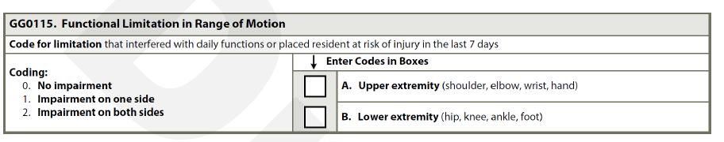
Section GG0155 –
Functional Limitation in Range of Motion
From G
DEFINITION – Functional Limitation in Range of Motion
  Limited ability to move a joint that interferes with daily functioning (particularly with activities of daily living) or places the resident at risk of injury.
Coding Tips and Examples Expanded

Slide 13
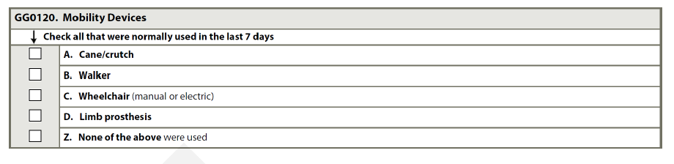
Section GG0120 – Mobility Devices
From G

Slide 14
Section GG – Look back periods
Stand‐alone 5 day (Medicare Part A Admission) – first three days of the Part A stay
OBRA Admission – first three days of the stay starting with the entry date
  If combined with the 5‐day, the look‐back period is the first thee days of the start of Medicare Part A
Interim Payment Assessment (IPA) – ARD and 2 previous days
Part A Discharge – End date of Medicare Part A stay and 2 previous days
OBRA discharge – Discharge date plus 2 previous days
OBRA other than admission – ARD plus 2 previous days

Slide 15
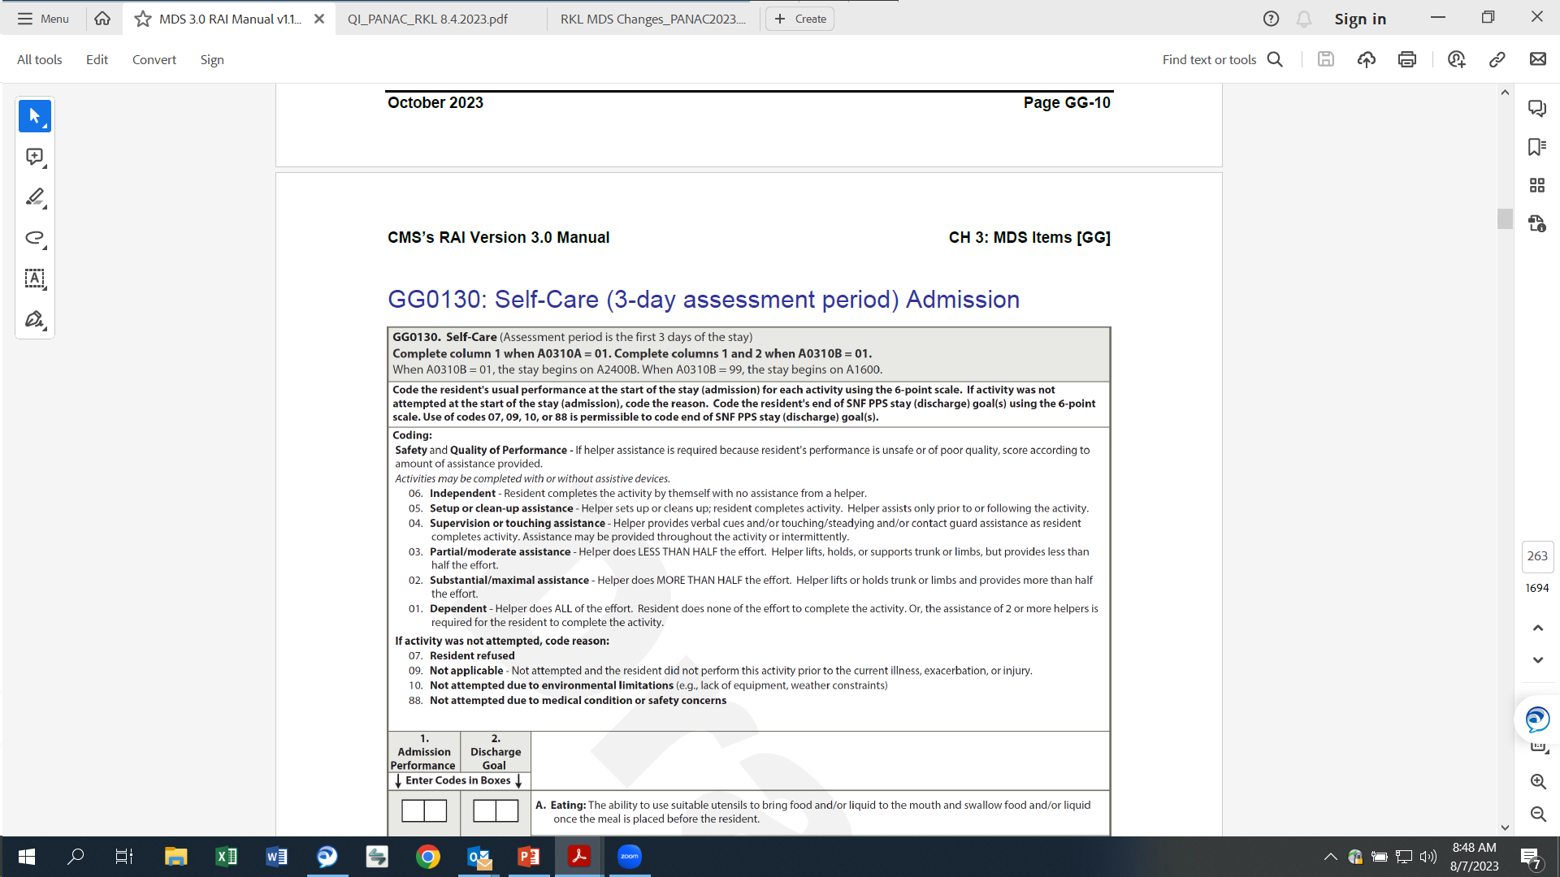
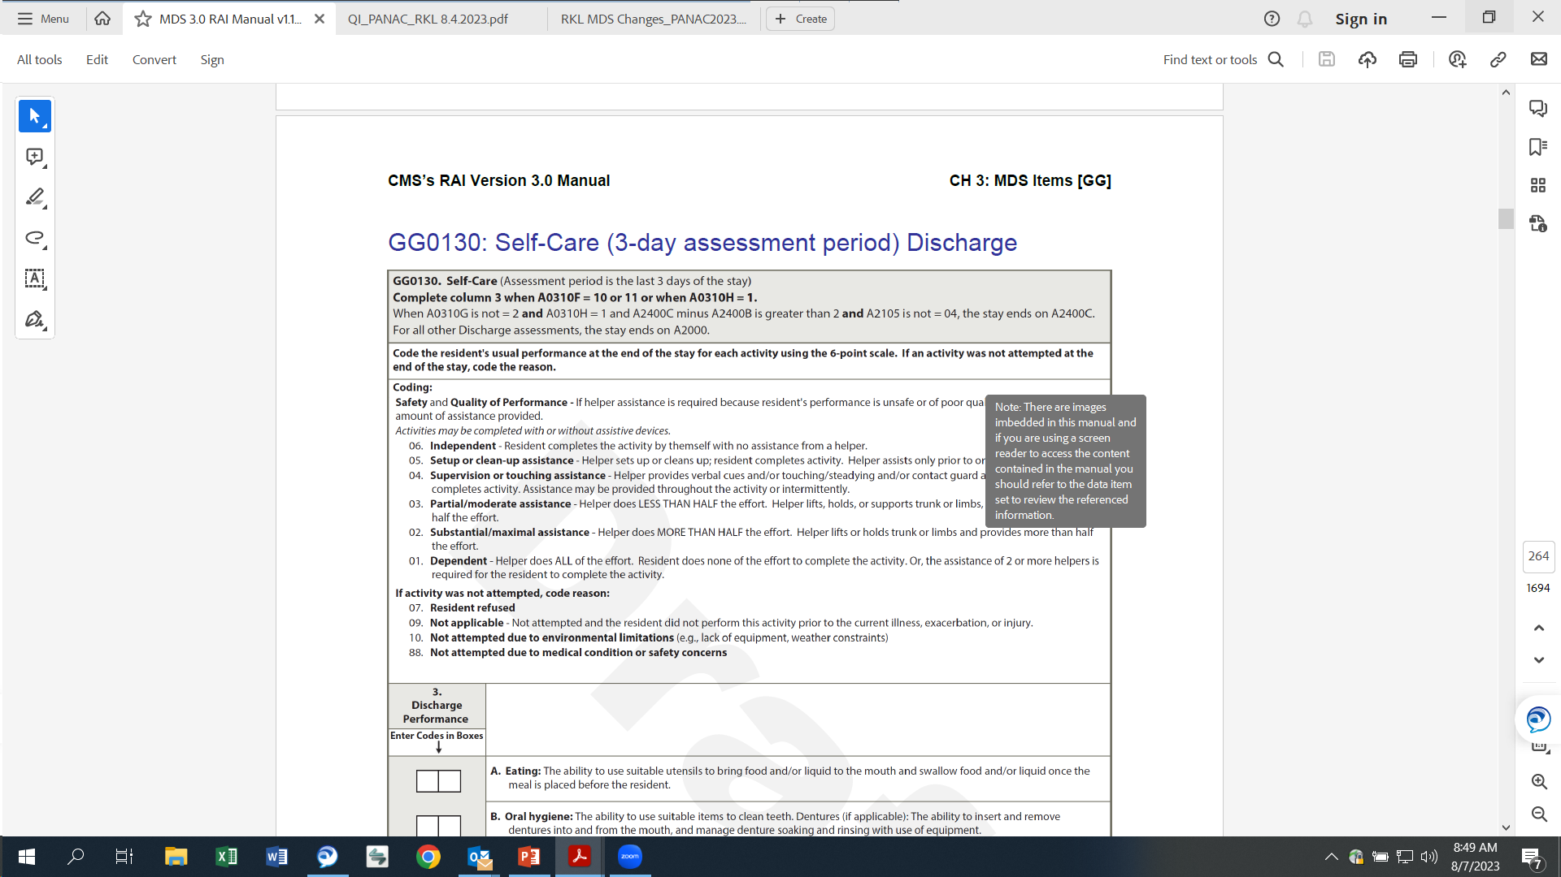
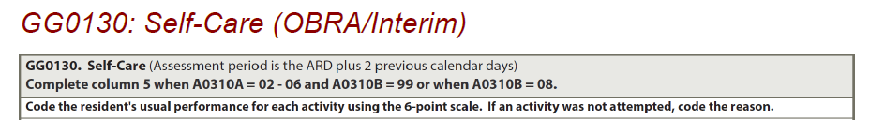
GG0130: Self Care

Slide 16
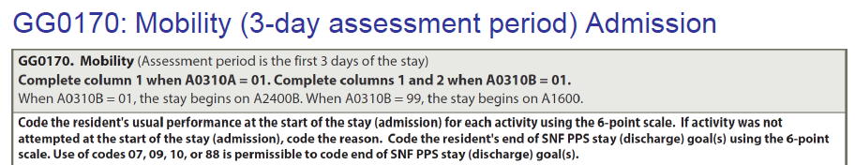
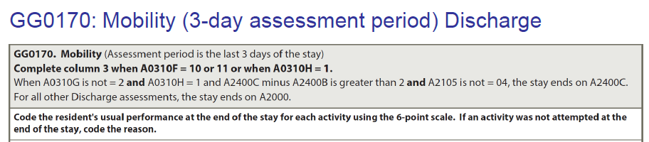
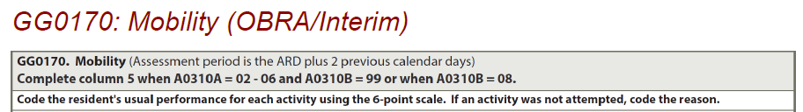
GG0170: Mobility

Slide 17
Section GG – Additional Instructions
Admission Functional Assessment
Clarified
For residents in a Medicare Part A stay, the admission functional
assessment, when possible, should be conducted prior to the
benefit of services in order to reflect the resident’s true admission
baseline functional status. If treatment has started, for example, on
the day of admission, a baseline functional status assessment can
still be conducted. Treatment should not be withheld in order to
conduct the functional assessment.
Prior to the benefit of services means prior to provision of any care by facility staff that would result in more independent coding.

Slide 18
Section GG – Discharge Goals
Clarified
Coded with each admission assessment, when there is a start of PPS stay
Discharge goals are not required with stand alone OBRA assessments.
For the SNF Quality Reporting Program (QRP), a minimum of one self
care or mobility goal must be coded. However, facilities may choose to
complete more than one self - care or mobility discharge goal.
Identifying multiple goals helps ensure that the assessment accurately
reflects resident status and facilitates person - centered individualized
care planning.

Slide 19
Section GG - Coding Instructions
Clarified
Code 06, Independent: if the resident completes the activity by themself with no assistance from a helper.
Code 05, Setup or clean-up assistance: if the helper sets up or cleans up; resident completes activity. Helper assists only prior to or following the activity, but not during the activity. For example, the resident requires assistance cutting up food or opening container, or requires setup of hygiene item(s) or assistive device(s).
Code 04, Supervision or touching assistance: if the helper provides verbal cues or touching/steadying/contact guard assistance as resident completes activity. Assistance may be provided throughout the activity or intermittently. For example, the resident requires verbal cueing, coaxing, or general supervision for safety to complete activity; or resident may require only incidental help such as contact guard or steadying assist during the activity.
  Code 04, Supervision or touching assistance: if the resident requires only verbal cueing to complete the activity safely.

Slide 20
Section GG – Coding Instructions
Code 03, Partial/moderate assistance: if the helper does LESS THAN HALF the effort. Helper lifts, holds, or supports trunk or limbs, but provides less than half the effort.
Code 02, Substantial/maximal assistance: if the helper does MORE THAN HALF the effort. Helper lifts or holds trunk or limbs and provides more than half the effort.

Slide 21
Section GG – Coding Instructions
Clarified
Code 01, Dependent: if the helper does ALL of the effort. Resident does none of the effort to complete the activity; or the assistance of two or more helpers is required for the resident to complete the activity.
  Code 01, Dependent: if two helpers are required for the safe completion of an activity, even if the second helper provides supervision/stand-by assist only and does not end up needing to provide hands-on assistance.
  Code 01, Dependent: if a resident requires the assistance of two helpers to complete an activity (one to provide support to the resident and a second to manage the necessary equipment to allow the activity to be completed).

Slide 22
Section GG – Coding Instructions
Code 07, Resident refused: if the resident refused to complete the activity.
Code 09, Not applicable: if the activity was not attempted and the resident did not perform this activity prior to the current illness, exacerbation, or injury.
Code 10, Not attempted due to environmental limitations: if the resident did not attempt this activity due to environmental limitations. Examples include lack of equipment and weather constraints.
Code 88, Not attempted due to medical condition or safety concerns: if the activity was not attempted due to medical condition or safety concerns.

Slide 23
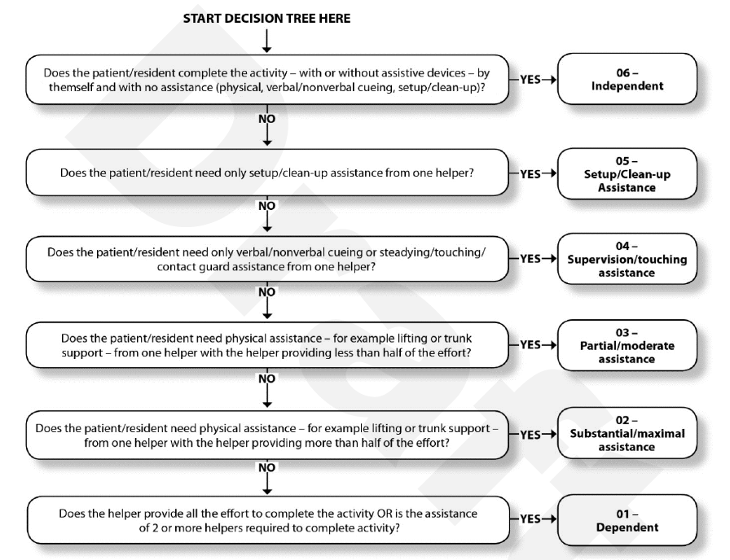
Decision Tree

Slide 24


Section GG - Coding Tips Added

Slide 25
Self Care Coding Tips
New
Eating – Eating is to assess the resident’s ability to use suitable utensils to bring food and/or liquid to the mouth and swallow food and/or liquid once the meal is placed before the resident.
Oral Hygiene - For a resident who is edentulous, code Oral Hygiene based on the type and amount of assistance required from a helper to clean the resident’s gums.
Toileting Hygiene - Includes performing perineal hygiene, managing clothing (including undergarments and incontinence products, such as briefs or pads) before and after voiding or having a bowel movement; and adjusting clothing relevant to the individual resident

Slide 26
Self Care Coding Tips (cont.)
New
Shower/bathe self - any location including in bed or assessed with the resident seated on a tub bench
  Code 05, Setup or clean-up assistance, if the resident can complete bathing tasks only after a helper retrieves or sets up supplies necessary to perform the included tasks
Dressing - If a resident requires assistance with dressing, including assistance with buttons, fasteners and/or fastening a bra, code based on the type and amount of assistance required to complete the entire dressing activity.

Slide 27
Self Care Coding Tips (cont.)
New
Personal hygiene - Personal hygiene involves the ability to maintain personal hygiene, including combing hair, shaving, applying makeup, and washing and drying face and hands (excludes baths, showers, and oral hygiene).
  Not included in stand-alone PPS assessment

Slide 28
Mobility Coding Tips
New
Roll left and right - If the resident does not sleep in a bed, clinicians should assess bed mobility activities using the alternative furniture on which the resident sleeps
Lying to sitting on side of bed - removed residents feet touching floor
Sit to stand - The activity includes the resident coming to a standing position from any sitting surface; If a full-body lift is used to assist in transferring a resident for a chair/bed-to-chair transfer code with the appropriate “activity not attempted” code

Slide 29
Mobility Coding Tips (cont.)
New
Chair/bed-to-chair transfer - transfer can be stand-pivot, squat-pivot, or a slide board transfer.
  The assessment begins with the resident sitting at the edge of the bed (or alternative sleeping surface) and ends with the resident sitting in a chair or wheelchair
  When possible, the transfer should be assessed in an environmental situation in which taking more than a few steps would not be necessary to complete the transfer.

Slide 30
Mobility Coding Tips (cont.)
New
Toilet Transfer - Toilet transfer includes the resident’s ability to get on and off a toilet (with or without a raised toilet seat) or bedside commode.
  Toileting hygiene, clothing management, and transferring on and off a bedpan are not considered part of the Toilet transfer activity.
  Code as 05, Setup or clean-up assistance, if the resident requires a helper to position/set up the bedside commode before and/or after the resident’s bed-to-commode transfers (place at an accessible angle/location next to the bed) and the resident does not require helper assistance during Toilet transfers.

Slide 31
Mobility Coding Tips (cont.)
New
Tub/shower transfer - Tub/shower transfers involve the ability to get into and out of the tub or shower.
  Do not include washing, rinsing, drying, or any other bathing activities in this item.
  If the resident does not get into or out of a tub and/or shower during the observation period, use one of the “activity not attempted” codes (07, 09, 10, or 88).

Slide 32
Mobility Coding Tips (cont.)
New
Car transfer -
Does not include getting to or from the vehicle, opening/closing the car door, or fastening/unfastening the seat belt.
If the resident remains in a wheelchair and does not transfer in and out of a car or van seat, then the activity is not considered completed, and the appropriate “activity not attempted” code would be used

Slide 33
Mobility Coding Tips (cont.)
New
Walking - Assessment of the walking activities starts with the resident in a standing position.
  A walking activity cannot be completed without some level of resident participation that allows resident ambulation to occur for the entire stated distance. A helper cannot complete a walking activity for a resident.
  During a walking activity, a resident may take a brief standing rest break. If the resident needs to sit to rest during a Section GG walking activity, consider the resident unable to complete the walking activity and use the appropriate activity not attempted code.
  Clinicians can use clinical judgment to determine how the actual resident assessment of walking is conducted. If a clinician chooses to combine the assessment of multiple walking activities, the clinician should use clinical judgment to determine the type and amount of assistance needed for each individual activity.

Slide 34
Mobility Coding Tips (cont.)
New
Walking - Assessment of the walking activities starts with the resident in a standing position.
  When coding GG0170K. Walk 150 feet, if the resident’s environment does not accommodate a walk of 150 feet without turns, but the resident demonstrates the ability to walk, with or without assistance, 150 feet with turns without jeopardizing the resident’s safety, code using the 6 - point scale.
  When coding GG0170L. Walking 10 feet on uneven surfaces, the activity can be assessed inside or outside. Examples of uneven surfaces include uneven or sloping surfaces, turf, and gravel. Use clinical judgment to determine whether a surface is uneven.

Slide 35
Mobility Coding Tips (cont.)
New
1 Step (curb), 4 Steps, 12 steps -
  Completing the stair activities indicates that a resident goes up and down the stairs, by any safe means, with or without any assistive devices (for example, railing or stair lift) and with or without some level of assistance. Getting to and from the stairs is not included when coding the curb or step activities.
  Ascending and descending stairs does not have to occur sequentially or during one session. If the assessment of going up the stairs and then down the stairs occurs sequentially, the resident may take a standing or seated rest break between ascending and descending the 4 steps or 12 steps.

Slide 36
Mobility Coding Tips (cont.)
New
1 Step (curb), 4 Steps, 12 steps -
  A resident who uses a wheelchair may be assessed going up and down stairs (including one step/curb) in a wheelchair. Code based on the type and amount of assistance required from the helper.
  If, at the time of the assessment, a resident is unable to complete the activity because of a physician - prescribed restriction (for instance, no stair climbing for 2 weeks) but could perform this activity prior to the current illness, exacerbation, or injury, code 88, Not attempted due to medical condition or safety concern.

Slide 37
Mobility Coding Tips (cont.)
New
Picking up object - The activity includes the resident bending or stooping from a standing position to pick up a small object, such as a spoon, from the floor.
  Picking up the object must be assessed while the resident is in a standing position. If the resident is not able to stand, the activity did not occur, and the appropriate “activity not attempted” code would be used
  If a standing resident is unable to pick up a small object from the floor, therefore requiring a helper to assist in picking up the object, code as 01, 02, or 03, depending on whether the helper is providing all the effort, more than half of the effort, or less than half of the effort, respectively.
  Assistive devices and adaptive equipment may be used, for example, a cane to support standing balance and/or a reacher to pick up the object.

Slide 38
Mobility Coding Tips (cont.)
New
Wheelchair Items - If the resident used a wheelchair for self-mobilization prior to admission to the facility, indicate 1, Yes, to the gateway wheelchair items on the initial assessment
  The Admission assessment may indicate that the resident does not use a wheelchair, but the subsequent assessment indicates that the resident uses a wheelchair.

Slide 39

Section H - Bladder and Bowel

Slide 40
Section H – Bladder and Bowel
Intent: The intent of the items in this section is to gather information on the use of bowel and bladder appliances, the use of and response to urinary toileting programs, urinary and bowel continence, bowel training programs, and bowel patterns. Each resident who is incontinent or at risk of developing incontinence should be identified, assessed, and provided with individualized treatment (medications, non-medicinal treatments and/or devices) and services to achieve or maintain as normal elimination function as possible.

Slide 41
Section H – Coding Tips
Clarified
Do not include one-time catheterizations for urine specimen collection or other diagnostic exams (e.g., to measure post-void residual) during look-back period as intermittent catheterization.
Added definition for Stress Incontinence: Episodes of a small amount of urine leakage only associated with physical movement or activity such as coughing, sneezing, laughing, lifting heavy objects, or exercise.

Slide 42

Section I – Active Diagnosis

Slide 43
Section I – Active Diagnosis
Intent: The items in this section are intended to code diseases that have a direct relationship to the resident’s current functional status, cognitive status, mood or behavior status, medical treatments, nursing monitoring, or risk of death. One of the important functions of the MDS assessment is to generate an updated, accurate picture of the resident’s current health status.

Slide 44
Section I – Coding Instructions
Added
When an acute condition represents the primary reason for the resident's SNF stay, it can be coded in I0020B. However, it is more common that a resident presents to the SNF for care related to an aftereffect of a disease, condition, or injury. Therefore, subsequent encounter or sequelae codes should be used

Slide 45
Section I – Example added
The resident was admitted without a diagnosis of schizophrenia. After admission, the resident is prescribed an antipsychotic medication for schizophrenia by the primary care physician. However, the resident’s medical record includes no documentation of a detailed evaluation by an appropriate practitioner of the resident’s mental, physical, psychosocial, and functional status (§483.45(e)) and persistent behaviors for six months prior to the start of the antipsychotic medication in accordance with professional standards.
  Coding: Schizophrenia item (I6000), would not be checked.
  Rationale: Although the resident has a physician diagnosis of schizophrenia and is receiving antipsychotic medications, coding the schizophrenia diagnosis would not be appropriate because of the lack of documentation of a detailed evaluation, in accordance with professional standards (§483.21(b)(3)(i)), of the resident’s mental, physical, psychosocial, and functional status (§483.45(e)) and persistent behaviors for the time period required.

Slide 46

Questions

Slide 47
Resources
https://www.cms.gov/files/document/draftmds-30-rai-manual-v11811october2023.pdf-0
https://www.cms.gov/medicare/quality-initiatives-patient-assessment-instruments/nursinghomequalityinits/mds30raimanual
https://www.youtube.com/cmshhsgov
This material was prepared by Quality Insights, a Quality Innovation Network - Quality Improvement Organization under contract with the Centers for Medicare & Medicaid Services (CMS), an agency of the U.S. Department of Health and Human Services (HHS). Views expressed in this material do not necessarily reflect the official views or policy of CMS or HHS, and any reference to a specific product or entity herein does not constitute endorsement of that product or entity by CMS or HHS. Publication number 12SOW-QI-GEN-080823-KS

