Slide 1




WV Behavioral Health Providers Association
Senior Leadership Conference
Certified Community Behavioral Health Clinics:
Advancing the WV Behavioral Health System

Slide 2
Acknowledgements
Governor Justice signed SB247, Advancing WV Certified Community Behavioral Health Clinics (CCBHC)
Advocacy and commitment from Christina Mullins, Commissioner of the Bureau for Behavioral Health and Cindy Beane, Commissioner of the Bureau for Medical Services
DHHR’s Cross-Bureau Team: Bureau for Public Health and Bureau for Social Services
West Virginia Behavioral Health Providers Association (WVBHPA)
CCBHC early adopters/current Substance Abuse and Mental Health Services Administration (SAMHSA) Grantees
Comprehensive Behavioral Health Centers
SAMHSA and the National Council for Mental Well-Being

Slide 3
What is a CCBHC?
Certified Community Behavioral Health Clinics (CCBHCs) are an integrated community behavioral health model of care that aims to improve service quality and accessibility. CCBHCs do the following:
Provide integrated, evidence-based, trauma-informed, recovery-oriented and person-and-family-centered care;
Offer the full array of CCBHC-required mental health, substance use disorder (SUD) and primary care screening services; and
Have established collaborative relationships with other providers and health care systems to ensure coordination of care.
*Must be a non-profit organization to be eligible.

Slide 4

National Council CCBHCs Video
https://www.thenationalcouncil.org/program/ccbhc-success-center/

Slide 5
Benefits of the CCBHC Model
National initiative
President Biden’s strategy to address our national mental health crisis
WV legislation
The CCBHC model gives states, clinics and grantees the tools needed to support a range of mental health and substance use challenges
The CCBHC model has been shown to improve health outcomes while lowering costs

Slide 6
Early Impact of CCBHC Demonstration Sites
The CCBHC demonstration increased access to mental health and substance use care, largely due to:
        Increased availability of same-day appointments
        Expanded hours of operation facilitated by increased hiring
        Concerted efforts to conduct outreach to underserved groups
States reported reductions in emergency department and hospital visits among CCBHC clients, leading to cost offsets
Helped states mitigate the effects of the mental health and substance use service workforce shortage by enabling clinics to hire and retain vital staff
Increased access to a comprehensive, evidence-based services to curb the opioid crisis, including medication-assisted treatment (MAT), the gold standard of care.
Source: Key highlights from the National Council’s Survey of State CCBHC Officials.

Slide 7
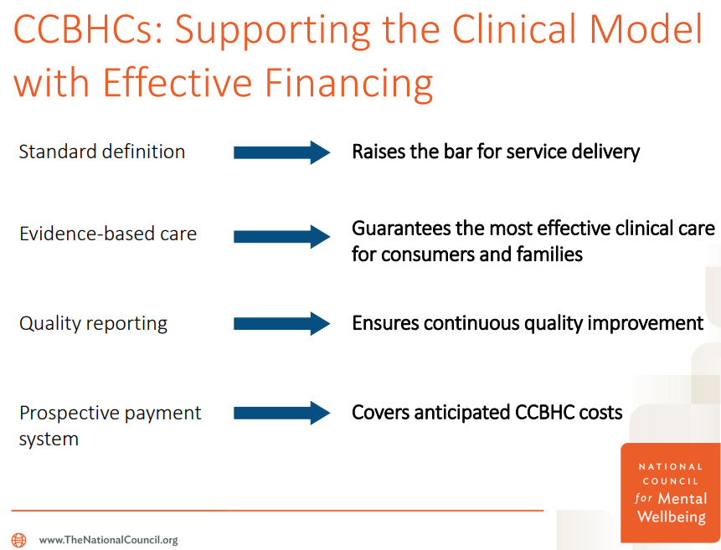
Support

Slide 8
What Goes Into Being a CCBHC?
CCBHC Criteria:
Organizational Authority
Staffing
Access to Care
Scope of Services
Care Coordination
Quality Reporting

Slide 9
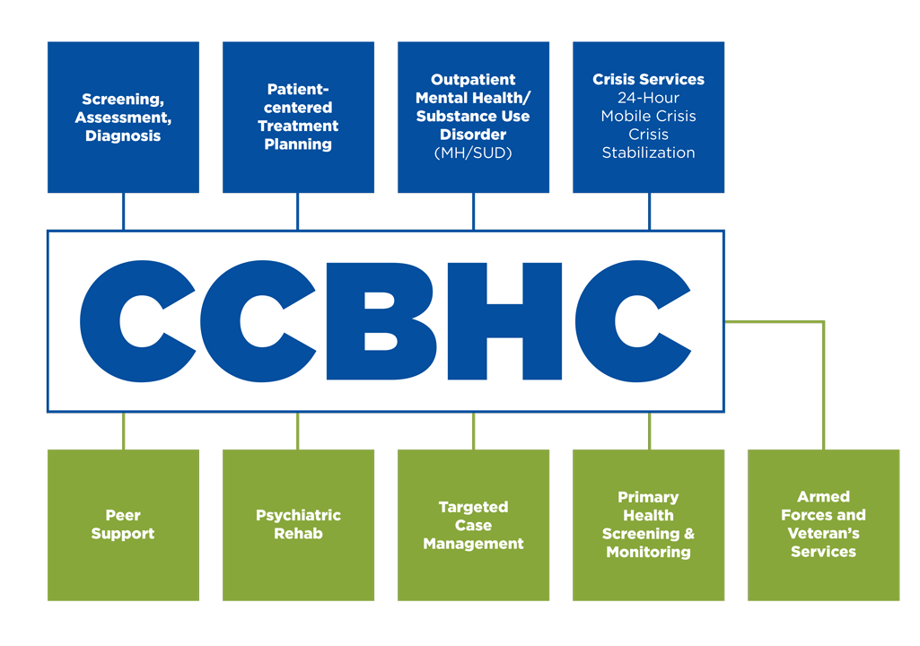
Nine Required CCBHC Services

Slide 10
Community Partnerships are Essential
Primary Care
Agency Provided
Veterans
Veterans Administration Medical Centers
Veterans Service Organizations
Crisis
988 Collaboration
Mobile Crisis
Suicide Hotline
Social Services
Bureau for Social Services
Local Private Practices
Federally Qualified Health Centers (FQHCs)
Homeless Services
Children’s Services
Community-Based Outpatient Clinics
Adult Services

Slide 11
Designated Collaborating Organization
Partner organizations that provide direct care
Must have 2+ years of experience providing the relevant services and meet applicable state licensing, accreditation and certification requirements
Augment or fill gaps in CCBHC service array
  Formal contracts/MOUs in place for delivery of services to CCBHC clients

Slide 12
Formal Partnerships with DCOs
CCBHCs must provide consumers with access to the nine required CCBHC services; however, they are not required to furnish all CCBHC services directly.
A subset of the required CCBHC services may be provided through “formal relationships with other providers” known as Designated Collaborating Organizations (DCOs). Under this relationship, the DCO furnishes a required CCBHC service or services on behalf of the CCBHC and is subject to various CCBHC requirements.
Care Coordination: In addition to furnishing CCBHC services, either directly or through DCOs, CCBHCs must coordinate care across a specific spectrum of safety-net services, including services like inpatient care, primary care and housing access.

Slide 13
Roadmap To Success
Completed/In Process
Contracted with Quality Insights for TA and Support
Prior to 7/31/2022
Finalize Draft WV Requirements
Prior to 1/1/2023
Complete Actuarial Analysis
Created WVBHPA & Internal CCBHC Planning Group
Discussions with Current CCBHC Grantees
Compiling State Needs Assessments
Began Draft WV Requirements
* Categories
* Required All Clinic Sites/Required At Least One
* Carve In/Out of Encounter Rate
* Metric/Evaluation
Define Standard Performance Measures
Begin Agency Readiness Assessments
Submit State Plan Amendment

Slide 14
Roadmap To Success
Prior to 6/30/2023
Develop BMS Policy
Success
Full implementation of CCBHCs
The development of resources to support agencies through the certification/ recertification process
Develop an Application, Certification and Recertification Process

Slide 15
CCBHC Requirement Building
CCBHC Requirements
DHHR Cross-Bureau Team has drafted initial draft
Agency Review
Beginning with May 25, 2022, Planning Meeting, WVBHPA will review, comment on, and discuss each requirement as drafted
Actuarial Review
Requirement draft submitted for review

Slide 16
CCBHC Requirements
Each requirement includes:
Definition of the requirement
Whether eligible for DCO
Whether requirement will be required at a minimum of one location, or for the agency’s full catchment area
If carved in/out of encounter rate
Metric/Evaluation Measure

Slide 17
CCBHC Requirement Example
A potential example of a requirement build out, using Assertive Community Treatment (ACT):
A CCBHC must operate an ACT team to ensure individuals can receive services in the community instead of institutional facilities
ACT Program cannot be contracted out to a DCO
ACT services will be carved out of encounter rate
ACT could be provided from at least one site, meaning service would not be required in full catchment area
Demonstrate active ACT Team at application and any renewals

Slide 18
Technical Assistance – Quality Insights
Serve as an inclusive, one-stop resource providing education and technical assistance to CCBHCs for CCBHC certification
Leverage organizational relationships and networks to align stakeholders and instill a shared vision that creates an environment conducive to certification progression
Lead and coordinate efforts with contracted Subject Matter Experts at Bowling Business Strategies to achieve each agency’s project goals
Launch and maintain an interactive Learning and Action Network for CCBHCs to learn, share and grow

Slide 19
Bowling Business Strategies
Provide Subject Matter Expertise and Technical Assistance on SAMHSA best practices for CCBHC certification
Conduct training sessions on CCBHC requirements for relevant stakeholders: including state leaders, providers, and technical assistance specialists
Assist in the development of work plans, readiness assessments and individualized certification pathways for CCBHCs
Provide input and feedback on the provision of technical assistance and development of tools and resources designed to support CCBHCs

Slide 20

Questions/Comments

Slide 21
Contact
Cynthia Parsons
Office Director
West Virginia Department of Health and Human Resources
Bureau for Medical Services
Address
Cynthia.A.Parsons@wv.gov
https://dhhr.wv.gov/bms
Jackie Payne
Behavioral Health Consultant
West Virginia Department of Health and Human Resources
Bureau for Behavioral Health
Address
Jacqueline.F.Payne@wv.gov
https://dhhr.wv.gov/bbh

