Slide 1


A Health Literacy Program for Patients with Chronic Kidney Disease

Slide 2
Making the Connection
Improve Education/Access to Home Dialysis Modality & Kidney Transplant
Reduce the Risk of Kidney Failure
Reducing Hospitalizations and ED Visits
Vaccinations
Pneumococcal | Influenza | COVID-19
Patient Engagement
Behavioral Health
Improve Access to and Quality of Person-Centered Treatment Options
Increase Access to Kidney Transplants

Slide 3

Literacy Delaware Description
For 40 years, Literacy Delaware has provided literacy instruction to adults in the state of Delaware.
Recruiting and training tutors help us achieve our mission.
Goal: all adults have proficient literacy skills

Slide 4




What is Literary Proficiency?
Notes:
Realizing the impact of health and literacy, we are thrilled to join network 4 and CC to provide this program.

Slide 5
National Institutes of Health estimates, 25% of individuals with Kidney Disease Renal Failure have low health literacy
Notes:
What is health literacy? https://health.gov/healthypeople/priority-areas/social-determinants-health/literature-summaries/health-literacy

Slide 6
The ABCs of Kidney Disease
Program Goals:
Increase Health Equity and Literacy
Equip patients with skills and tools to manage their health; build confidence
Improve health outcomes
A Patient & Family Focused
Health Literacy Program
Notes:
health literacy education program for dialysis patients and their families to close the health equity gap. The main goal of this program is to improve patients' understanding and management of their health by providing them with the skills and tools necessary to navigate their journey to improve their health outcomes.

Slide 7

Program Overview
Fall and Spring sessions
One class per week, 2 hours, 4 weeks
Lunch provided
Guest speakers
Target: Minimum 15 patients per class

Slide 8
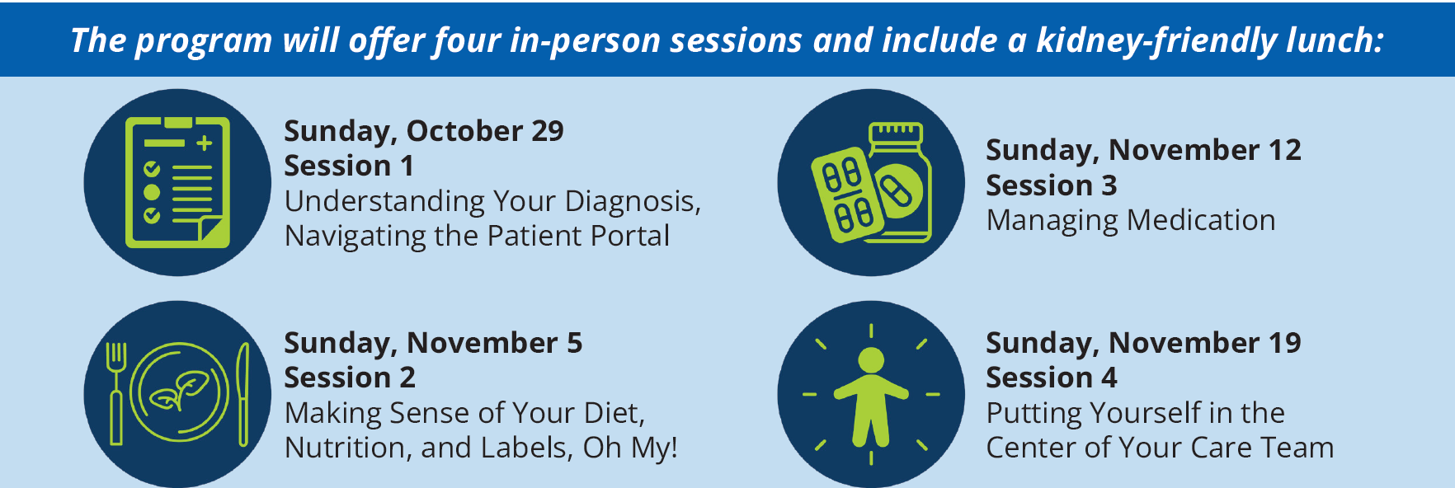
Program Details
All sessions will be held from 11-1pm @ Christiana Care Hospital Main Campus
4755 Ogletown Stanton Rd, Newark, DE 19718

Slide 9

All patients and their families are welcome!

Slide 10
Who could most benefit from the ABCs of Kidney Disease?
Who Could Most Benefit from the ABCs of Kidney Disease?
Individuals who exhibit potential indicators of limited health literacy
  Frequently missed treatments/appointments
  Incomplete registration forms
  Non-adherence with medication therapy
  Unable to name medications, explain purpose/dosing
  Difficulty reading medication labels
  Difficulty providing coherent, sequential history
  Ask fewer questions
  Lack of follow-through on test/referrals
Individuals living with mental illness
Adults age 65 and older
People with low income
Marginalized populations
Uninsured adults
Medicare and Medicaid recipients

Slide 11

We need your help!
Encourage your patients to register
Lunch at each session
Interactive activities and guest speakers

Slide 12
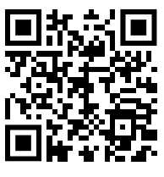


Now enrolling!
Now enrolling!
Patients can enroll themselves or you can enroll:
Using QR code
Link to enrollment form
Registration open until October 25th

Slide 13
Questions?
Contact:
Leslie McGowan
operations@literacydelaware.org
302.658.5624

Slide 14
Literacy Delaware

